Slide 1


Systems Engineering
The elements, or parts, can include people, hardware, software, facilities, policies, and documents; that is, all things required to produce system-level results.
Osman Mert Can Kaynak
Ankara,Temmuz 2021

Slide 2



What Is a system ?
System development models
What is systems engineering ?
who is system engineer ?
PRESENTATION CONTENT
Systems engineering processes
Organizatıonal structures
Technical Management Processes
SYSTEM ENGINEERING STANDARDS

Slide 3


What Is a System?
system is an organized collection of parts (or subsystems) that are highly integrated to accomplish an overall goal.
The system has various inputswhich together, accomplish the overall desired goal for the system.

Slide 4
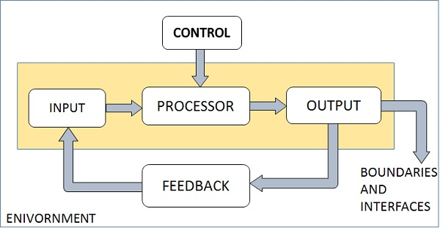

Elements of a System

Slide 5


WHAT IS SYSTEMS ENGINEERING ?
Systems Engineering is an interdisciplinary approach that provides the means to enable the realisation of successful complex systems.

Slide 6

Systems engineering processes
task definition (informative definition)
conceptual stage (cardinal definition)
design stage (formative definition)
implementation stage (manufacturing definition)

Slide 7


Requirements Management
Interface Management
Technical Management Processes
Decision Management
In order for a system to be managed correctly, technical management processes must be followed correctly.
Technical Performance Management

Slide 8

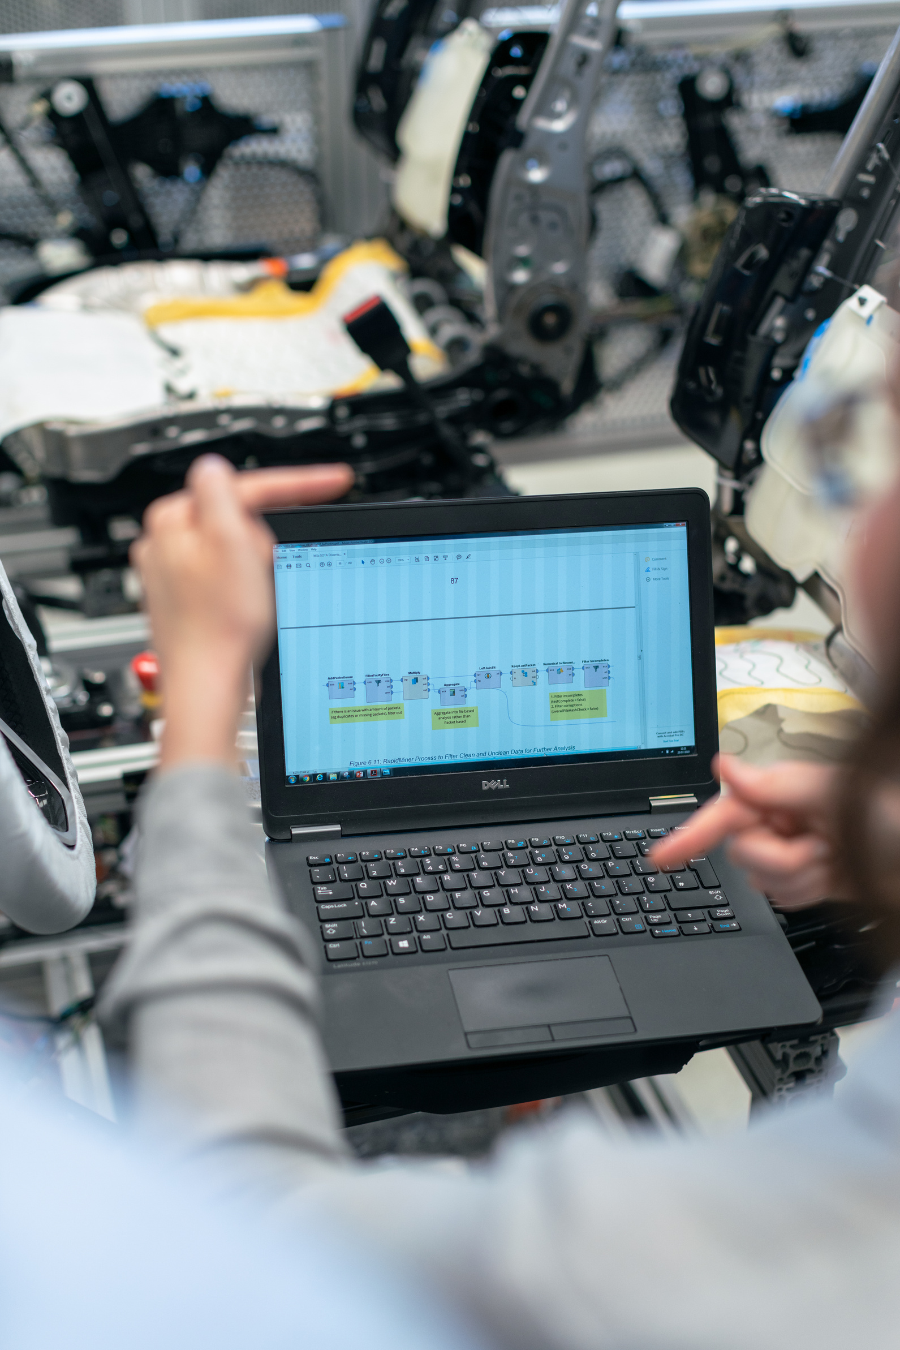
Technical Reviews and Audits
Work Distribution Tree
Technical Planning, Monitoring, Evaluation and Control
Risk management

Slide 9
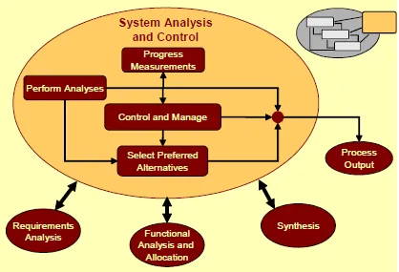
SYSTEM ANALYSIS AND CONTROL
System Analysis and Control manages and controls the overall Systems Engineering Process.
System Analysis and Control interacts with all the other activities of the Systems Engineering Process.

Slide 10


PLANNING, ORGANIZING, AND MANAGING.
Planning and Decision Making:
Determining Courses of Action,
Organizing:
Coordinating Activities and Resources

Slide 11


Leading:
Managing, Motivating and Directing People
Controlling:
Monitoring and Evaluating activities.

Slide 12

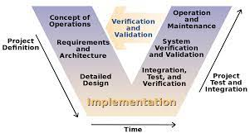
V-model
System development models

Slide 13


who is system engineer ?
It is the person who performs the production, design, maintenance and the infrastructures that make up the systems.
It works to carry out the systematic work of the project based on cost and time constraints.

Slide 14

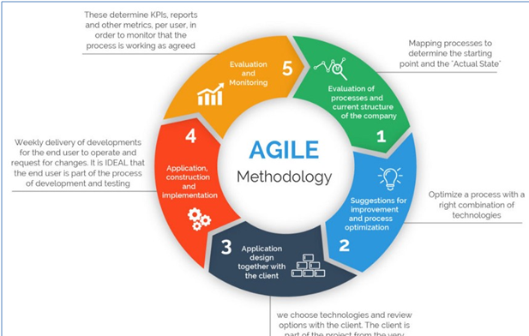


break down the requirements
a hierarchical, usually tree-shaped description of all project requirements which must be present in the end product in order to deliver the expected business value.

Slide 15
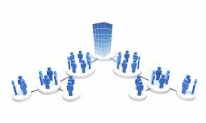
ORGANIZATIONAL STRUCTURES

Slide 16


Divisional Structure
The departmental structure is the second most common structure in America after the functional structure. It divides the work into sections.

Slide 17

Matrix Structure
The matrix structure is organized on the basis of both function and product. This build uses more teams to get things done.

Slide 18

Functional Structure
The most distinctive feature of this model is to leave the execution of the functions in the enterprise to the experts.

Slide 19




SYSTEM ENGINEERING STANDARDS
EIA/IS 632
Processes For Engineering System
ISO/IEC 15288
System Life Cycle Processes
CMMI-DEV v2.0
Organizations That Develop Products

Slide 20
A not-for-profit membership organization founded to develop and disseminate the transdisciplinary principles and practices that enable the realization of successful systems.
INCOSE (National Council on Systems Engineering).
INCOSE is designed to connect SE professionals with educational, networking, and career-advancement opportunities in the interest of developing the global community of systems engineers and systems approaches to problems.

Slide 21


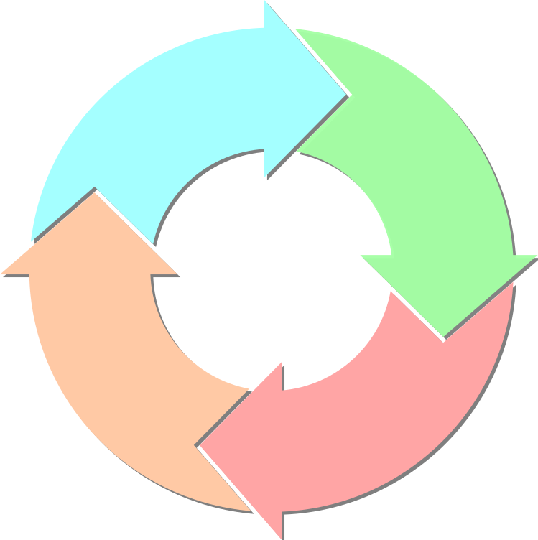
System Life Cycle
Budgetable Operational Efficiency
Life Cycle Cost

